Slide 1

#LifeKoKaroLift
Python Data Structures - 1

Slide 2



Instructor: Devesh Singh
LinkedIn: https://www.linkedin.com/in/deveshhh3/
Instagram: https://www.instagram.com/deveshhh3/
GitHub: https://github.com/deveshhh3/

Slide 3
What You’ll Learn
1
Understanding Python Data Structures
2
Primitive and Non-Primitive Data Structures
3
String Slicing and its importance
4
List/Set/Tuples/Dictionary

Slide 4
Understanding Data Structure
Data Structure
Data Structures are a way of organizing and storing data so that they can be accessed and worked with efficiently.
Common Operations performed on Data Structures:
Add an element
Update or Delete an element
Traverse
Sort the elements
Search for an element

Slide 5


















Slide 6














Slide 7




Slide 8
















Slide 9




Slide 10





Slide 11













Slide 12













Slide 13











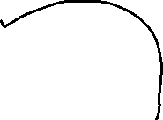

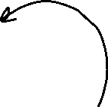

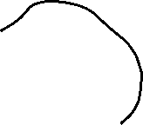



Slide 15

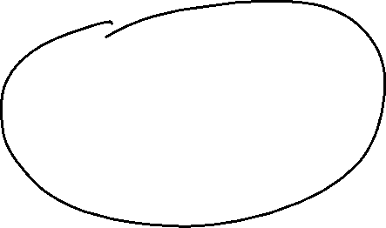

















Slide 16





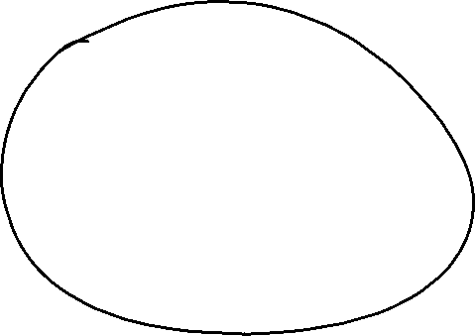






Slide 19
#LifeKoKaroLift
Thank You!

